Slide 1

Programming Assessment

Slide 2
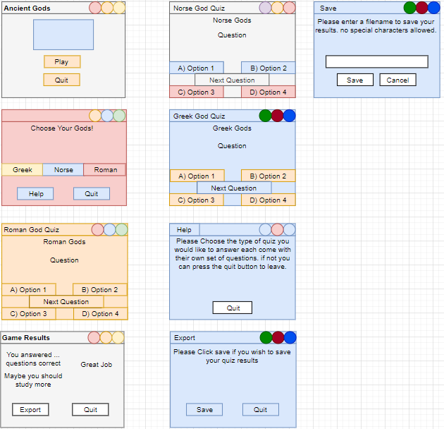
Quiz GUI Structure

Slide 3
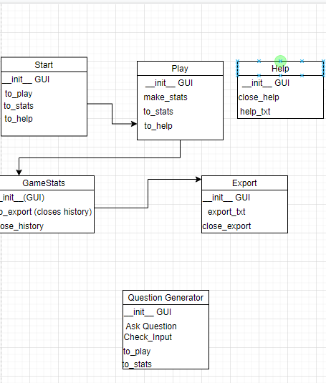
Program Structure
This is a plan of what my coding will need to have in each of my different components so I know what to write when I am doing the coding and making sure I have everything so that the components will work as they should be and I don’t miss out anything.

Slide 4
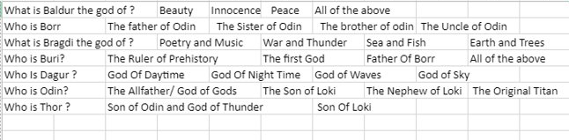
Questions Making
This was just a test of my questioning
But it is now not a good way to do my questions as it would be much easier if I just made a list of random answers that would go with the real answer instead of making having to make many different answers for each of my questions.

Slide 5
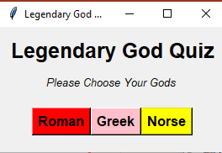
Quiz Start GUI
This is just the start of my quiz gui. I recycled most of the cod from a previous project that I had completed .

Slide 6
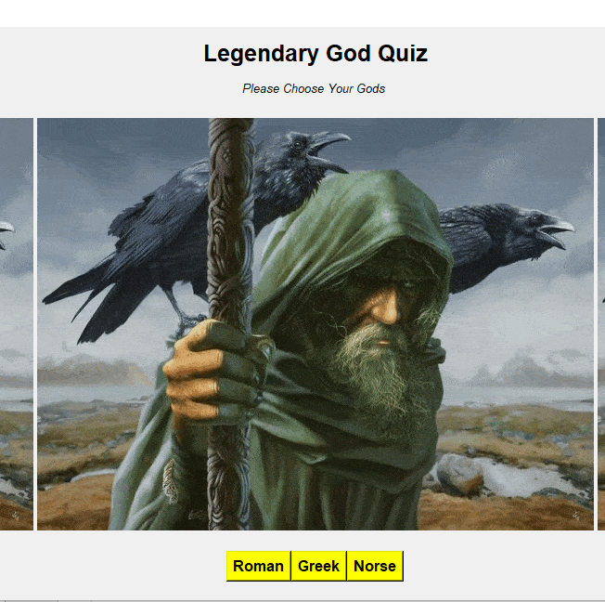
Start_Gui_V2
This is a very rough draft of what I intend my start Gui to look like. Ideally I want to make the pictures smaller and add 2 more pictures of the different gods from the roman and Greek periods I will also change the picture of the current god you can see.. And I would like to add a quit button Aswell.

Slide 7
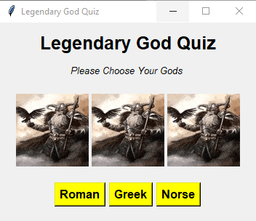
Quiz GUI v3
This is my third version of my start Gui. I will make it so that when you press one of the buttons it will take you to a quiz where it will display a question and give you 4 different answers. 1 of them will be correct and the other 3 will be randomly generated from a list of answers that I have designed

Slide 8
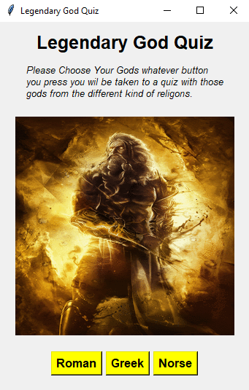
Start_GUI V4
This will most likely be my final version of my start Gui. I will now begin to develop my game glass and generate questions + answers. My start Gui now works as I intended it to.

Slide 9
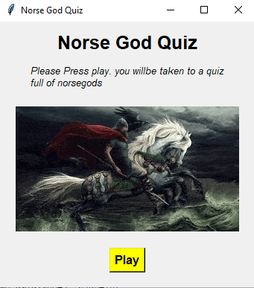
Start GUI V5
I have decided to remove the roman and Greek options from my quiz and just make it a quiz about the Norse Gods.
I made it like this as it would be easier for me to program and make it easier on me.

Slide 10
Start GUI Test Plan
Press Play Button.
Press Exit Button in the Top right.
Play Button Works
Exit Button also Works

Slide 11
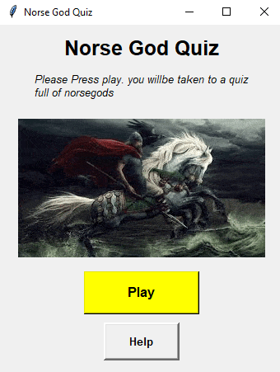
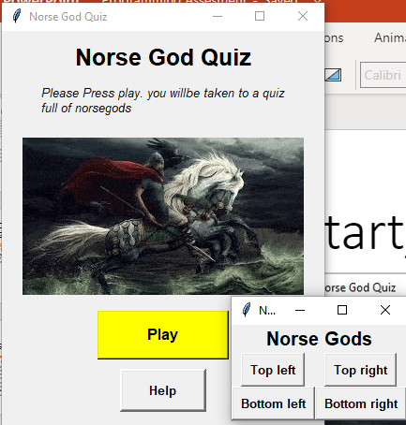
Start Gui Final + Start of game GUI
This is the final version of my start gui and I have begun developing my game class which you can see with the buttons. I will now make it so the game GUI is a lot more improved along with it getting the question and making it so you can choose your answers.

Slide 12
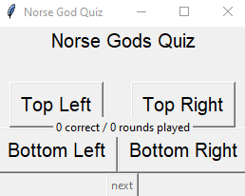
Game Class V1
This is my first iteration of my game class. I now need to make it grab the Questions And answers from the list that I created so that you can actually play the quiz.

Slide 13
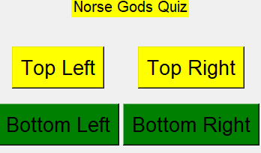
GAME CLASS V_2
I have changed my gui up a bit, but I am yet to get my buttons configured so that it will show me the questions + answers when it needs to. I also plan to add a picture of a Norse god above the answers.

Slide 14
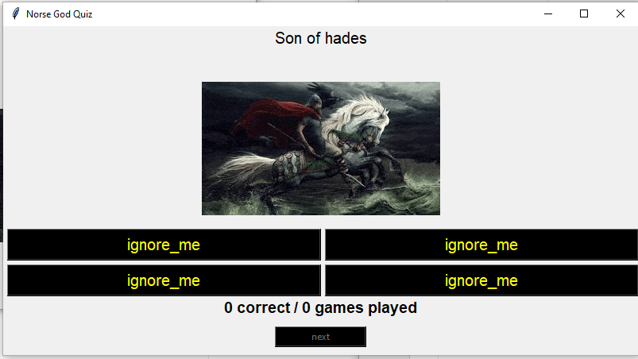
Game Class V_3
This is my second version of my game class. I have added the picture I wanted to add and got my questions and answers configured but it is showing the invalids in my csv file. I will need to fix this in my code so that it will work as it is intended.

Slide 15
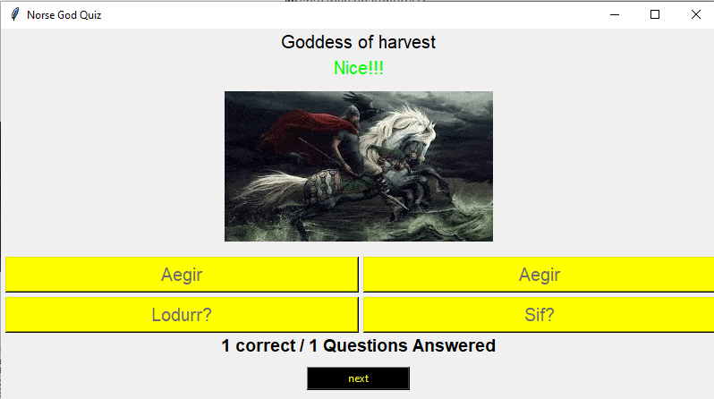
Game GUI V_3
Have fixed the bit of my code that was broken and not allowing me to generate my questions and answers now that is working perfectly fine. I would like to add a help, export and stats button to my quiz before I can move on to my history and stats Gui

Slide 16
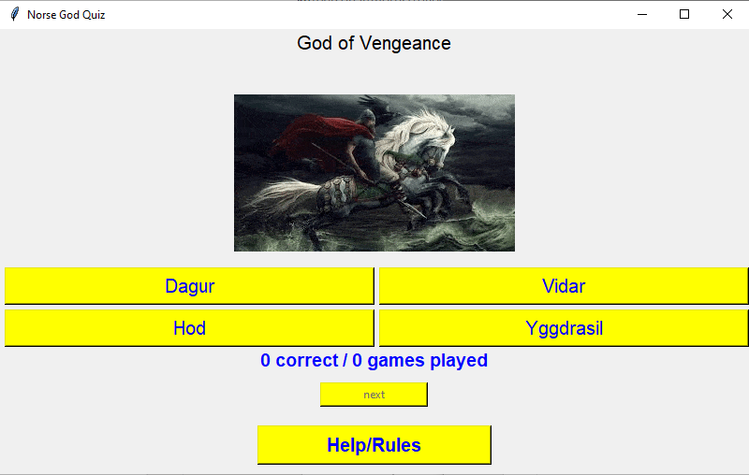
Game_GUI V_4
Added help button. This is final version of game class

Slide 17
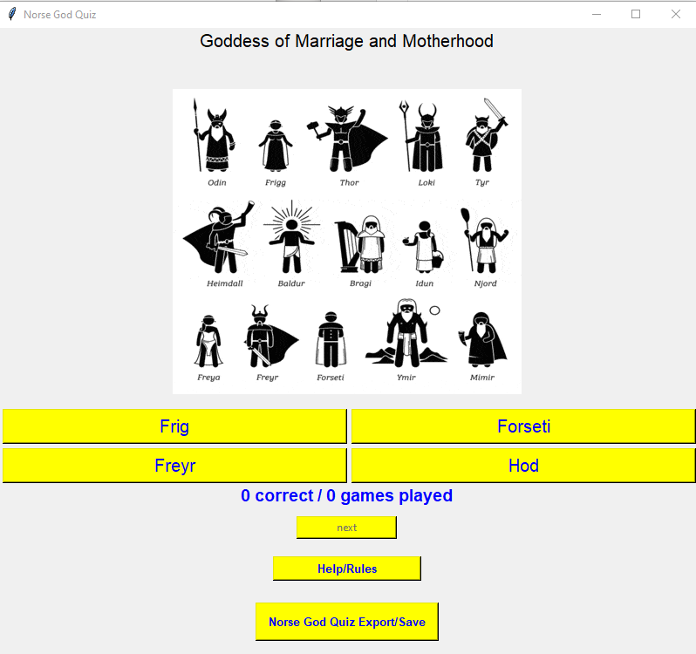
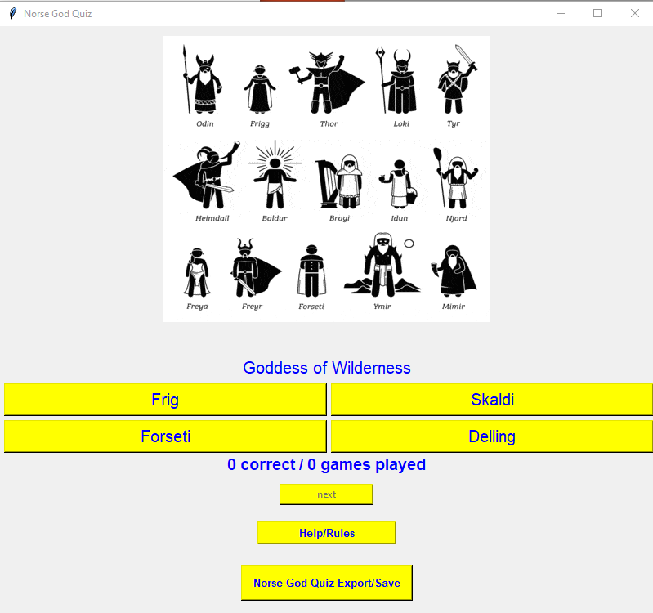
Game_GUI Final
This is the final version of my game gui. I have added the export/save button and have made sure that my question generation is working perfectly fine. I will now work on my help classes and then my history class.
I have changed where the Question is in a more logical place
The picture in my GUI is not a hint but it is rather there to help the gui look flashier.

Slide 18
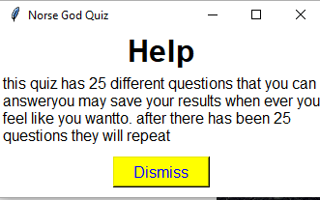
Help_GUI V1
First version of my help class. It is working and doing what it needs to. I can now shift my attention to my history and export classes.
I recycled most of the code from a previous project that I worked on.

Slide 19
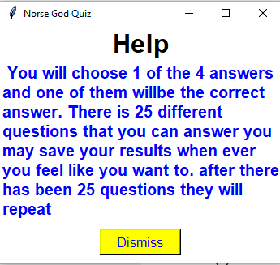
Help GUI_V2
Updated my help GUI to make it clearer to those that read it and do need help when they do the quiz. Will need to make it even better which you will see in my next Help Gui

Slide 20
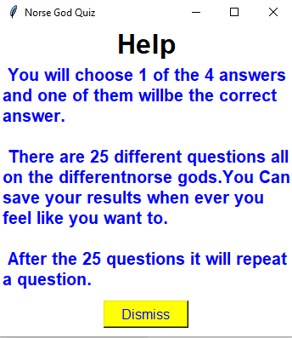
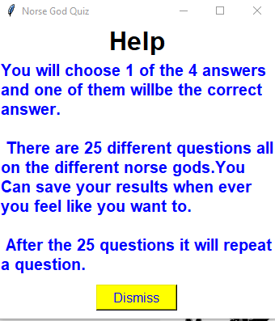
Help GUI Final
Have updated my help class so that the instructions / help are clear so that it is easier to find what you are looking for. One difference in the code was to hold the help text in a different string in the label. This made it easier to direct yourself to where you are.
Have fixed an error I made in the text

Slide 21
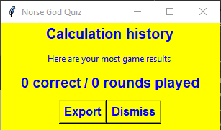
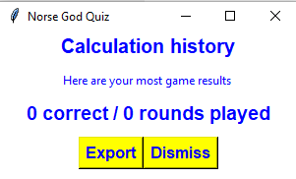
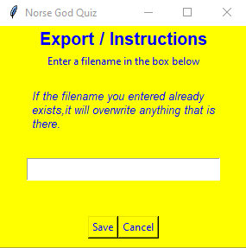
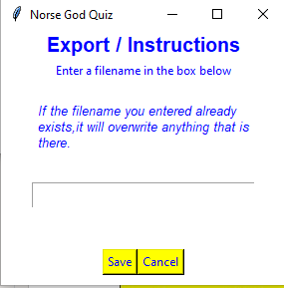
History + Export Classes
First version of my History class will leave it for now as I need to finish the assessment asap and now, I can focus on my stats and export classes
I recycled most of the code from a previous project that I worked on.
This Export class is from mystery box, and it works exactly how it should. This will be my first and final version of my export class. I will come back to it if I need to.​
I recycled most of the code from a previous project that I worked on.

